Slide 1
CS60055: Ubiquitous Computing
Location, Gesture and Activity Sensing
Part II: Odometry to Motion Tracking

Slide 2
What We Have Learnt So Far?
IMU: Accelerometer, Gyroscope, Magnetometer
The IMU accelerometers measure true acceleration
  A static accelerometer placed on Earth's surface will read the gravitational acceleration in its vertical axis
To measure the coordinate acceleration, we need to subtract gravitational offset
  Need to compute the roll, pitch and yaw angles when the accelerometer is in any arbitrary orientation
Using only accelerometer data, we can compute two of the three angles
  Need gyroscope to measure the yaw angle
Combine the readings from all the three sensors to estimate the true orientation of an object

Slide 3

Our Next Problem
Let we calculate the orientation of an object using the IMU measures and the Euler angles method, and then subtract the gravitational offset computed over the three axes to obtain the coordinate acceleration of an object
Can we use this instantaneous values of the coordinate acceleration to estimate the movement trajectory of the object?
Animation Source: https://medium.com/@rocchokcoco/motion-path-magical-path-animation-6f9f36c621b3

Slide 4
The Naïve Approach
Let a_{t} be the measured acceleration at time t; t ∈ [t₁, t₂, t₃, …, t_{n}]
  Let we sample at small time gaps Δt = t₂ – t₁ = t₃ - t₂ = … = t_{n} – t_{n-1}
Use numerical integration over a_{t} to measure the velocity v_{t} at each time instances t₂, t₃, …, t_{n}
Finally, use numerical integration over v_{t} to measure the displacement x_{t} at each of the time instances t₂, t₃, …, t_{n}

Slide 5
The Naïve Approach
Let a_{t} be the measured acceleration at time t; t ∈ [t₁, t₂, t₃, …, t_{n}]
  Let we sample at small time gaps Δt = t₂ – t₁ = t₃ - t₂ = … = t_{n} – t_{n-1}
Use numerical integration over a_{t} to measure the velocity v_{t} at each time instances t₂, t₃, …, t_{n}
Finally, use numerical integration over v_{t} to measure the displacement x_{t} at each of the time instances t₂, t₃, …, t_{n}

Slide 6
The Naïve Approach
Let a_{t} be the measured acceleration at time t; t ∈ [t₁, t₂, t₃, …, t_{n}]
  Let we sample at small time gaps Δt = t₂ – t₁ = t₃ - t₂ = … = t_{n} – t_{n-1}
Use numerical integration over a_{t} to measure the velocity v_{t} at each time instances t₂, t₃, …, t_{n}
Finally, use numerical integration over v_{t} to measure the displacement x_{t} at each of the time instances t₂, t₃, …, t_{n}

Slide 7
The Naïve Approach
Let a_{t} be the measured acceleration at time t; t ∈ [t₁, t₂, t₃, …, t_{n}]
  Let we sample at small time gaps Δt = t₂ – t₁ = t₃ - t₂ = … = t_{n} – t_{n-1}
Use numerical integration over a_{t} to measure the velocity v_{t} at each time instances t₂, t₃, …, t_{n}
Finally, use numerical integration over v_{t} to measure the displacement x_{t} at each of the time instances t₂, t₃, …, t_{n}
Do you see any potential issue with this approach?

Slide 8
Fallacy in Trajectory Estimation
The double integration induces significant errors in the estimation, the error will keep on added up when you add the respective displacement values

Slide 9
Fallacy in Trajectory Estimation
The double integration induces significant errors in the estimation, the error will keep on added up when you add the respective displacement values
The problem becomes much severe if the orientation keeps on changing

Slide 10
How Can You Reduce the Error?
Can you think of a parameter that will reduce the integration error?

Slide 11
How Can You Reduce the Error?
Can you think of a parameter that will reduce the integration error?
  Angular velocity: We get it from gyroscope
  We can use the Euler angle method to subtract the gravitational offset
  A single integration over the coordinate angular velocity will give angular displacement
  But how do we convert angular displacement to linear displacement?

Slide 12
How Can You Reduce the Error?
Can you think of a parameter that will reduce the integration error?
  Angular velocity: We get it from gyroscope
  We can use the Euler angle method to subtract the gravitational offset
  A single integration over the coordinate angular velocity will give angular displacement
  But how do we convert angular displacement to linear displacement?
Our conjecture: At infinitesimally small time-scale, the angular displacement with respect to one axes gives the linear displacement with respect to the plane perpendicular to it (constructed by the other two axes)

Slide 13

Angular Displacement to Linear Displacement
Z
Φ
Y
Integrate Φ with respect to time to compute the motion path across the y-z plane.
X

Slide 14

Tracking the Arm
ACM MobiSys 2016

Slide 15

Let's See a Video First ...

Slide 16
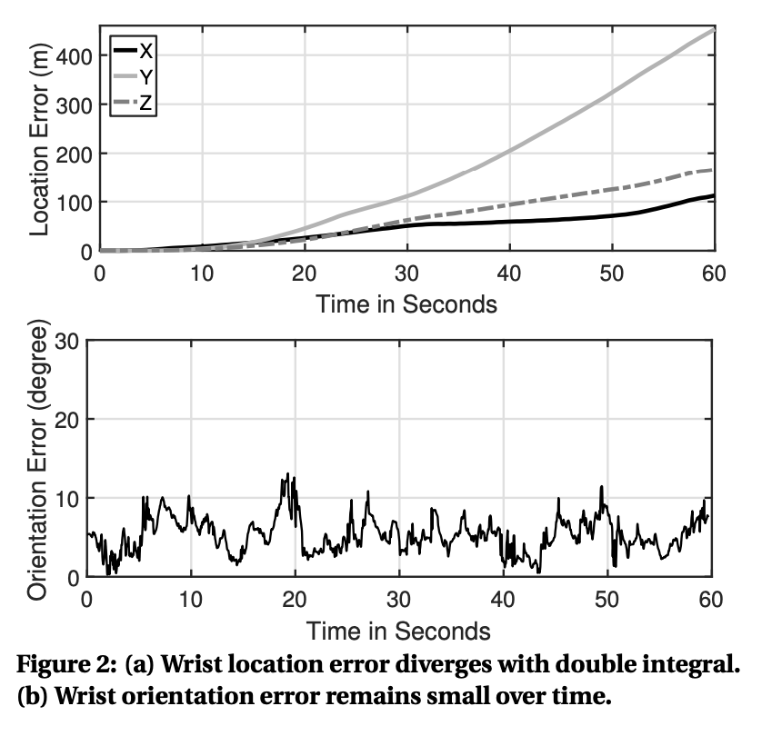
Basic Insights
Gyroscope is good in capturing the orientation of the arm, but accelerometer fails to capture the arm location (as we have seen earlier …)

Slide 17
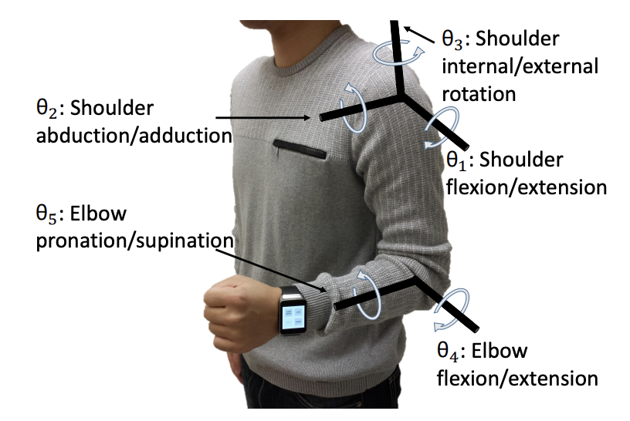
Basic Insights
Gyroscope is good in capturing the orientation of the arm, but accelerometer fails to capture the arm location (as we have seen earlier …)
The arm movement is not fully random
  There are predefined (5) degrees of freedom

Slide 18
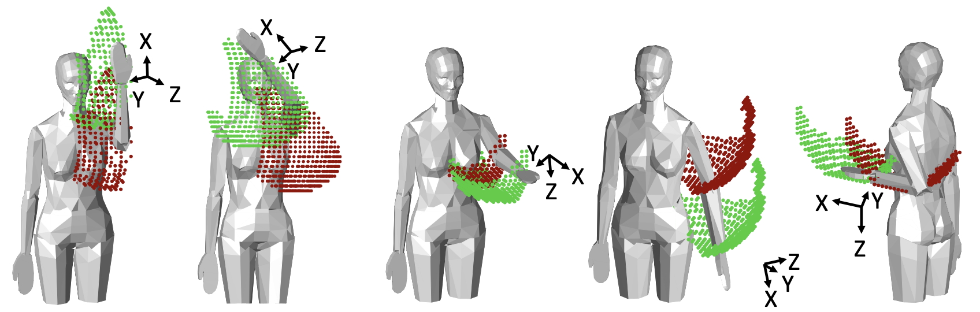
Basic Insights
Gyroscope is good in capturing the orientation of the arm, but accelerometer fails to capture the arm location (as we have seen earlier …)
The arm movement is not fully random
  There are predefined (5) degrees of freedom
  Accordingly, there can be possible gestures

Slide 19
Basic Insights
Gyroscope is good in capturing the orientation of the arm, but accelerometer fails to capture the arm location (as we have seen earlier …)
The arm movement is not fully random
  There are predefined (5) degrees of freedom
  Accordingly, there can be possible gestures
Can we use watch's orientation to detect/predict these gestures?

Slide 20
Basic Insights
Core Idea: If you fix the orientation of the smartwatch, then there can be a fixed number of possible movements
Gyroscope is good in capturing the orientation of the arm, but accelerometer fails to capture the arm location (as we have seen earlier …)
The arm movement is not fully random
  There are predefined (5) degrees of freedom
  Accordingly, there can be possible gestures

Slide 21
Basic Insights
However, this number is large!
Can we use the orientation information to fix the localization error?
Gyroscope is good in capturing the orientation of the arm, but accelerometer fails to capture the arm location (as we have seen earlier …)
The arm movement is not fully random
  There are predefined (5) degrees of freedom
  Accordingly, there can be possible gestures

Slide 22
We Need a Fixed Coordinate System
Torso Coordinate System (TCS)
  The left shoulder is the origin
  The plane of the user's torso (i.e., the chest) is the XY plane
  The Z axis will be the line emanating from the left shoulder in the frontward direction, perpendicular to the torso

Slide 23
We Need a Fixed Coordinate System
Torso Coordinate System (TCS)
  The left shoulder is the origin
  The plane of the user's torso (i.e., the chest) is the XY plane
  The Z axis will be the line emanating from the left shoulder in the frontward direction, perpendicular to the torso
An interesting system: Can you convert the TCS to the Global Coordinate System (GCS)?
  Some application needs GCS; for example, pointing a TV remote towards the TV

Slide 24
We Need a Fixed Coordinate System
Torso Coordinate System (TCS)
  The left shoulder is the origin
  The plane of the user's torso (i.e., the chest) is the XY plane
  The Z axis will be the line emanating from the left shoulder in the frontward direction, perpendicular to the torso
An interesting system: Can you convert the TCS to the Global Coordinate System (GCS)?
  Some application needs GCS; for example, pointing a TV remote towards the TV
  The compass in the watch can be used to map TCS to GCS, but you need the facing direction
  ArmTrack assumes that the facing direction is available!

Slide 25
We Need a Fixed Coordinate System
Torso Coordinate System (TCS)
  The left shoulder is the origin
  The plane of the user's torso (i.e., the chest) is the XY plane
  The Z axis will be the line emanating from the left shoulder in the frontward direction, perpendicular to the torso
An interesting system: Can you convert the TCS to the Global Coordinate System (GCS)?
  Some application needs GCS; for example, pointing a TV remote towards the TV
  The compass in the watch can be used to map TCS to GCS, but you need the facing direction
  ArmTrack assumes that the facing direction is available!
Both the orientation and the location of the smartwatch can be represented with respect to this TCS. We need the gravity offset subtraction to map the IMU readings to the TCS.

Slide 26
The Physics
Hypothesis: A motion of a body can be decomposed into translational and rotational motions
Movement of a watch from Point A to Point B
  A translational motion from A to B
  A rotational motion to change the orientation at B

Slide 27
The Physics
Hypothesis: A motion of a body can be decomposed into translational and rotational motions
Movement of a watch from Point A to Point B
  A translational motion from A to B
  A rotational motion to change the orientation at B
Assume that you know the coordinate of Point A at TCS, and the accelerometer and gyroscope readings are super accurate!
  Use double integration on accelerometer (after gravity offset subtraction) to estimate the translational shift
  Use gyroscope to estimate the orientation at Point B (we have seen this earlier)

Slide 28
The Physics
Hypothesis: A motion of a body can be decomposed into translational and rotational motions
Movement of a watch from Point A to Point B
  A translational motion from A to B
  A rotational motion to change the orientation at B
Assume that you know the coordinate of Point A at TCS, and the accelerometer and gyroscope readings are super accurate!
  Use double integration on accelerometer (after gravity offset subtraction) to estimate the translational shift
  Use gyroscope to estimate the orientation at Point B (we have seen this earlier)
  But unfortunately, this method does not work because of the reasons we discussed!

Slide 29
Using the Human Arm Kinematics
Considering the 5-DoF, we have three parameters to model:
  Wriest orientation
  Wrist location
  Elbow location

Slide 30
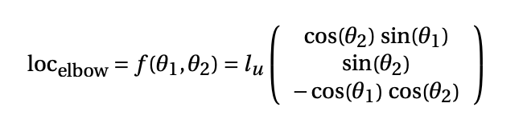

Using the Human Arm Kinematics
Considering the 5-DoF, we have three parameters to model:
  Wriest orientation
  Wrist location
  Elbow location
Let l_{u} and l_{f} define the length of the upper
arm and the forearm
The elbow location can be estimated using
Denavit-Hartenberg transformation:
https://en.wikipedia.org/wiki/Denavit%E2%80%93Hartenberg_parameters

Slide 31
Using the Human Arm Kinematics
Considering the 5-DoF, we have three parameters to model:
  Wriest orientation
  Wrist location
  Elbow location
Let l_{u} and l_{f} define the length of the upper
arm and the forearm
The elbow location can be estimated using
Denavit-Hartenberg transformation:
https://en.wikipedia.org/wiki/Denavit%E2%80%93Hartenberg_parameters

Slide 32


Using the Human Arm Kinematics
Considering the 5-DoF, we have three parameters to model:
  Wriest orientation
  Wrist location
  Elbow location
Let l_{u} and l_{f} define the length of the upper
arm and the forearm
Similarly, the wrist's relative location to
elbow can also be computed:
https://en.wikipedia.org/wiki/Denavit%E2%80%93Hartenberg_parameters

Slide 33


Using the Human Arm Kinematics
Finally, the location of the wrist becomes a function,
The orientation of the wrist is also a
function of the 5-DoFs
So, if we know the five θs, we can solve the
entire arm posture; wrist orientation,
wrist location, and elbow location
https://en.wikipedia.org/wiki/Denavit%E2%80%93Hartenberg_parameters

Slide 34

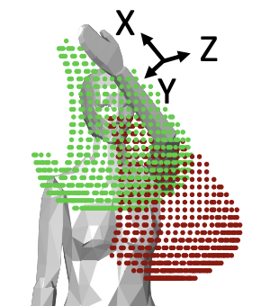
Mapping Orientation to Point Cloud
Input: Watch Orientation
Output: Elbow and Wrist's location point cloud

Slide 35
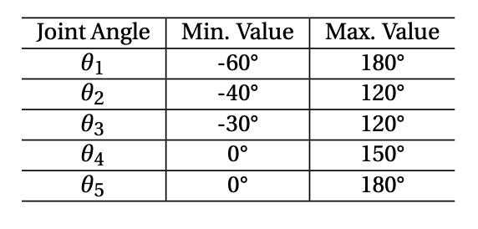
Mapping Orientation to Point Cloud
Input: Watch Orientation
Output: Elbow and Wrist's location point cloud
Hypothesis: The average range of motion for
each joint angle is fixed!
  So, we know what can be their possible ranges! Use the
  previous set of equations to generate all possible combinations

Slide 36
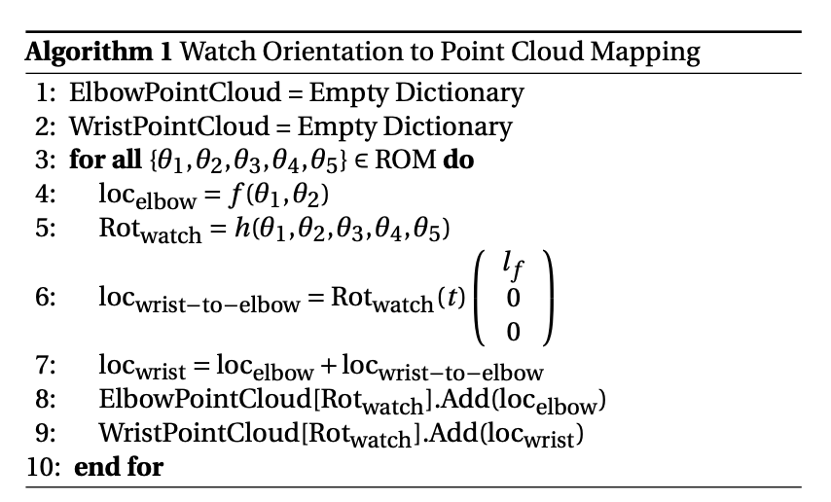
Watch Orientation to Point Cloud Mapping

Slide 37
From Point Cloud to Elbow Location Estimation
Once the orientation of the watch is known, posture estimation boils down to the elbow tracking problem
  Wrist location can be computed as a static shift
We have the following information
  Reasonable estimate of orientation (may not be fully precise)
  Point cloud of all possible elbow locations, for a given orientation
At any given time, where is the elbow in the point cloud?

Slide 38
From Point Cloud to Elbow Location Estimation
Can be thought of as the state estimation framework
  Given the current location, you know the next possible locations. If you know the possible displacement direction, can you estimate what would be the next location?

Slide 39
From Point Cloud to Location Estimation
Can be thought of as the state estimation framework
  Given the current location, you know the next possible locations. If you know the possible displacement direction, can you estimate what would be the next location?

Slide 40
From Point Cloud to Location Estimation
Can be thought of as the state estimation framework
  Given the current location, you know the next possible locations. If you know the possible displacement direction, can you estimate what would be the next location?

Slide 41
From Point Cloud to Location Estimation
Can be thought of as the state estimation framework
  Given the current location, you know the next possible locations. If you know the possible displacement direction, can you estimate what would be the next location?

Slide 42
From Point Cloud to Location Estimation
Can be thought of as the state estimation framework
  Given the current location, you know the next possible locations. If you know the possible displacement direction, can you estimate what would be the next location?

Slide 43
From Point Cloud to Location Estimation
Can be thought of as the state estimation framework
  Given the current location, you know the next possible locations. If you know the possible displacement direction, can you estimate what would be the next location?

Slide 44
From Point Cloud to Location Estimation
Can be thought of as the state estimation framework
  Given the current location, you know the next possible locations. If you know the possible displacement direction, can you estimate what would be the next location?

Slide 45
From Point Cloud to Location Estimation
Can be thought of as the state estimation framework
  Given the current location, you know the next possible locations. If you know the possible displacement direction, can you estimate what would be the next location?
Motivates a discrete space hidden Markov model
  With Elbow's point cloud as the prior
Note that all the points in the point cloud are
not equally likely
  Depends on the general human arm movement
  kinematics, depending on the location of the elbow
  Use a Posture Prior Module (PPM) to determine priors

Slide 46
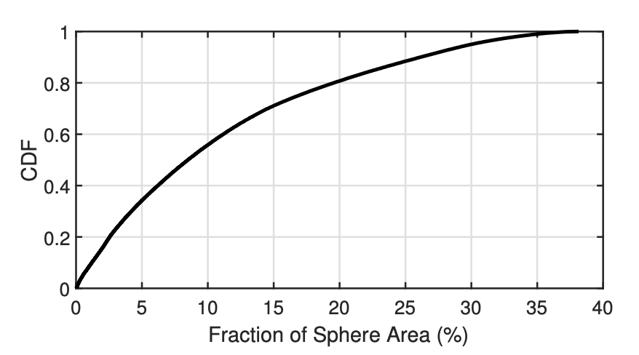

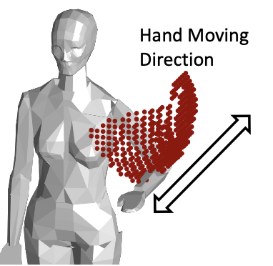
A Simple Solution May Work for Many Problems
You may not need a very high accuracy all the time (say, eating episode detection)
Note that, the point cloud is often quite small
  Covers less than 10% of the sphere around the shoulder
Simply using the average location of the point cloud
may provide a good estimate
However, this may not work for all the gestures
  Consider the case of punching

Slide 47
Scope for Improvement
As we discussed earlier, smartwatch sensors can work as an estimate of the elbow's movement
  For punching, the accelerometer shows accleration to a straight direction

Slide 48

Scope for Improvement
As we discussed earlier, smartwatch sensors can work as an estimate of the elbow's movement
  For punching, the accelerometer shows accleration to a straight direction
However, this is complicated in the reality, as the
elbow may also have rotational motions
  Acceleration has to be
  computed as a fusion
  of accelerometer and
  gyroscope

Slide 49
Using the Motion Vectors for Fine Corrections
We have seen earlier how to estimate the acceleration in the presence of rotational motion.
Use that formulation to ask the question: Which sequence of elbow locations best matches the measured elbow acceleration?
A dynamic programming problem: Given the point cloud at each time step, find out the location that matches with the target acceleration.
  Use a Hidden Markov Model (HMM) to solve this problem: Iteratively search the optimal solution in the search space (point cloud locations)

Slide 50
The Hidden Markov Model
State Space: <Elbow's previous location, Elbow's current location>
Prior Probability: Uniform probability
  As we do not know the initial elbow location
Transition Probability: Product of three probabilities
  Since the elbow transition is continuous, two successive locations will nearly be the same (considering time to be infinitesimally small).
    An indicator variable denoting whether two successive location is the same
  The acceleration computed between two successive states (location -> velocity -> acceleration) should be equal to the target observed acceleration from the IMU. Assume that the error difference follows Gaussian distribution
  The current elbow location in the new state must be inside the point cloud inferred at that point of time: Probability that the current location is inside the computed point cloud

Slide 51
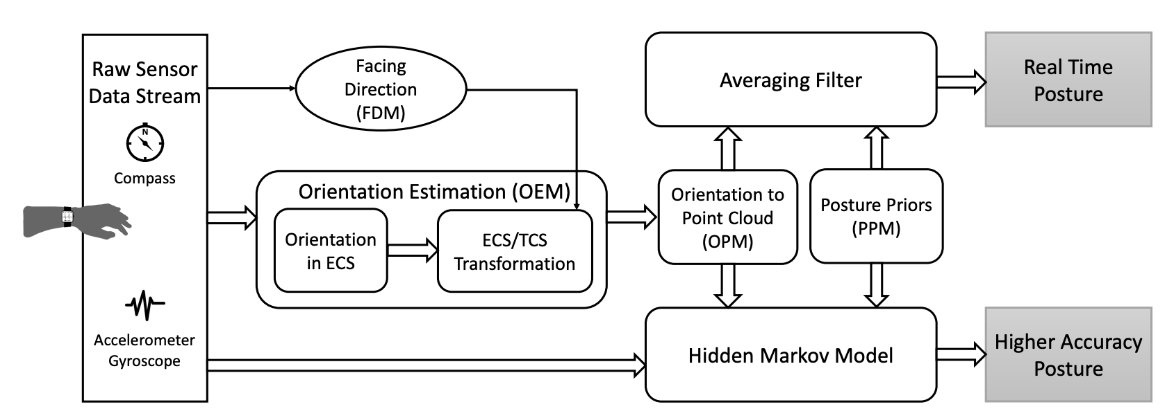
ArmTrak Architecture

Slide 52
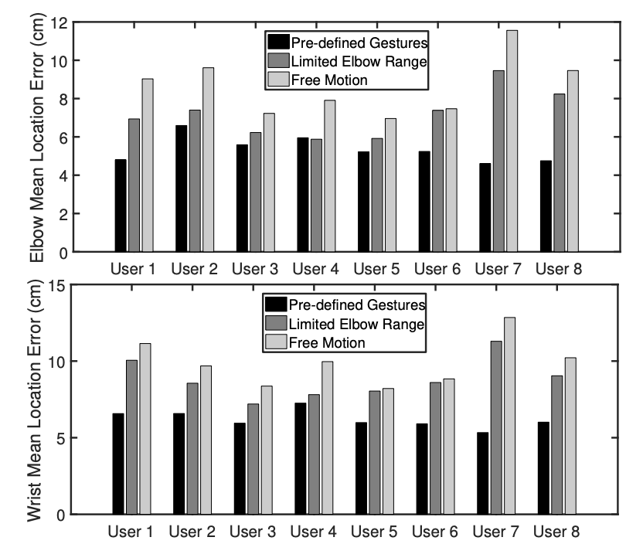
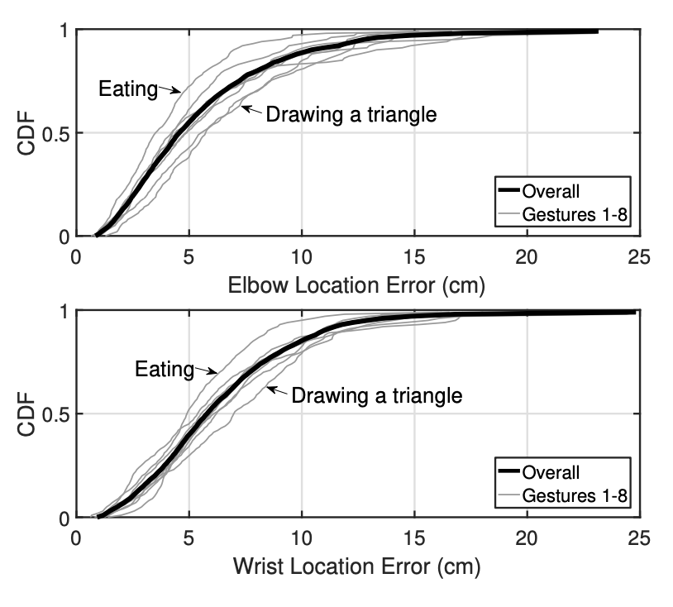
Performance of ArmTrak

Slide 53
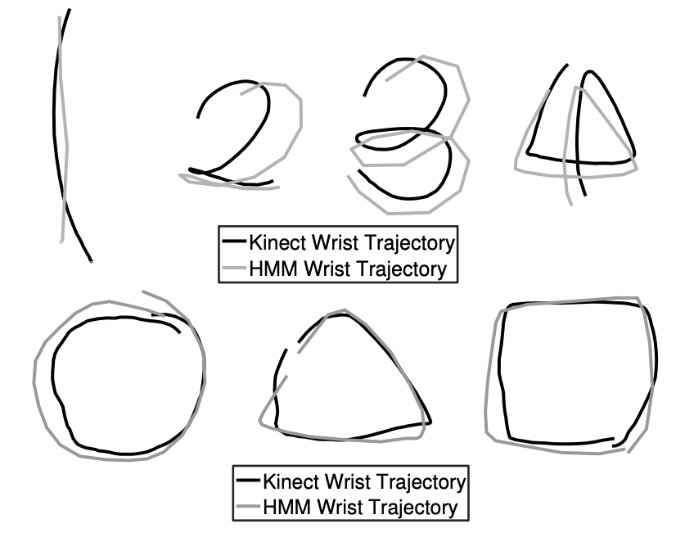
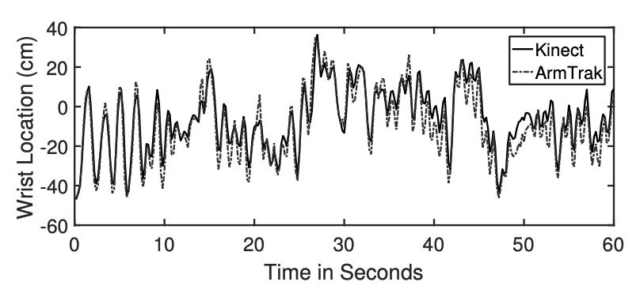
Performance of ArmTrak

Slide 54





Happy Learning!
Some resources related to this topic

